Slide 1


OMGT1039
Operations Management
Week 7
Aggregate Planning and Master Schedule

Slide 2
COMMONWEALTH OF AUSTRALIA
Copyright Regulations 1969
WARNING
This material has been reproduced and communicated
to you by or on behalf of Royal Melbourne Institute
of Technology, (RMIT University) pursuant to Part
VB of the Copyright Act 1968 (the Act).
The material in this communication may be subject to
copyright under the Act. Any further reproduction or
communication of this material by you may be the
subject of copyright protection under the Act.
Do not remove this notice.
First page of scanned document
This presentation includes selected slides from
William J Stevenson (2015) Operations Management, 12 ed. ISBN 10: 1259580091, McGraw Hill

Slide 3
Learning Objectives
You should be able to:
  Explain what aggregate planning is and how it is useful
  Identify the variables decision makers have to work with in aggregate planning
  Describe some of the strategies that can be used for meeting uneven demand
  Describe some of the graphical and quantitative techniques planners use
  Prepare aggregate plans and compute their costs

Slide 4
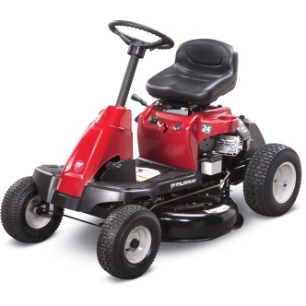

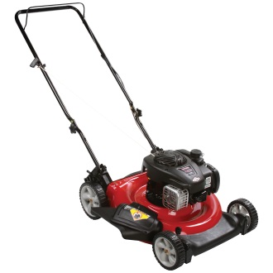
Aggregate Planning
Aggregate planning
  Intermediate-range capacity planning that typically covers a time horizon of 2 to 18 months
  Useful for organizations that experience seasonal, or other variations in demand
  Goal:
    Achieve a production plan that will effectively utilise the organisation’s resources to satisfy demand

Slide 5
Overview of planning levels
Short Range Plan
Production lot size (Week 6)
Order quantities (Week 6)
Machine loading (Week 10)
Job assignments (Week 10)
Job sequencing (Week 10)
Work schedules (Week 10)
Long Range Plan
Product Design (Week 3)
Process Design (Week 3)
Long term capacity (Chapter 5)
Intermediate Plan
Aggregate Planning (Week 7)

Slide 6
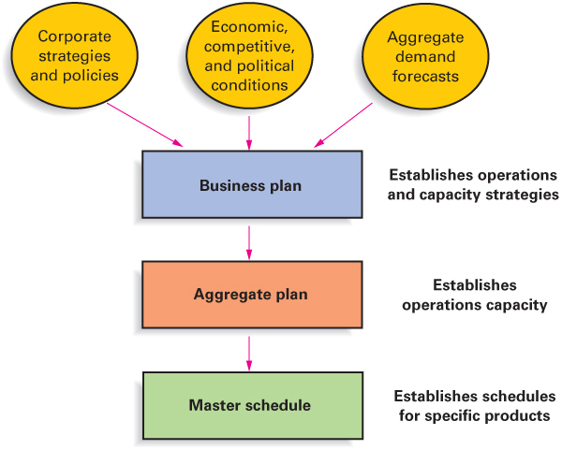
The Planning Sequence

Slide 7
Why Use Aggregate Planning
Why do organizations need to do aggregate planning?
  Planning
    It takes time to implement plans
  Strategic
    Aggregation is important because it is not possible to predict with accuracy the timing and volume of demand for individual items
  Budgeting process
  Supply chain

Slide 8
Demand and Supply
Aggregate planners are concerned with
  Demand quantity
    If demand exceeds capacity, attempt to achieve balance by altering capacity, demand, or both
  Timing of demand
    Even if demand and capacity are approximately equal, planners still often have to deal with uneven demand within the planning period

Slide 9
Aggregate Planning Strategies
Capacity = Demand
Proactive
  Alter demand to match capacity
Reactive
  Alter capacity to match demand
Mixed
  Some of each

Slide 10
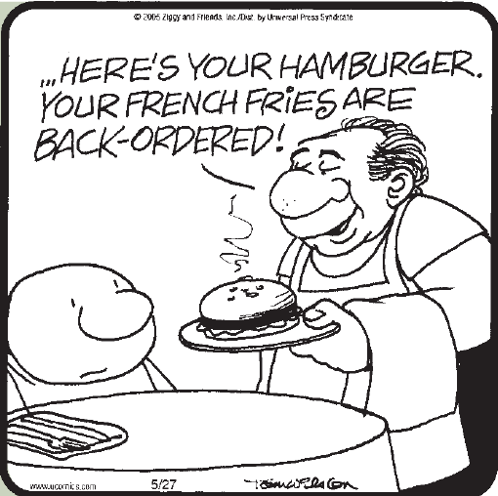
Demand Options
Pricing
  Used to shift demand from peak to off-peak periods
  Price elasticity is important
Promotion
  Advertising and other forms of promotion
Back orders
  Orders are taken in one period and deliveries promised for a later period
New demand

Slide 11
Capacity Options
Hire and layoff workers
Overtime/slack time
Part-time workers
Inventories
Subcontracting

Slide 12
Aggregate Planning Pure Strategies
Level capacity strategy:
  Maintaining a steady rate of regular-time output while meeting variations in demand by a combination of options:
    inventories, overtime, part-time workers, subcontracting, and back orders
Chase demand strategy:
  Matching capacity to demand; the planned output for a period is set at the expected demand for that period.
  Use a combination of decision variables

Slide 13
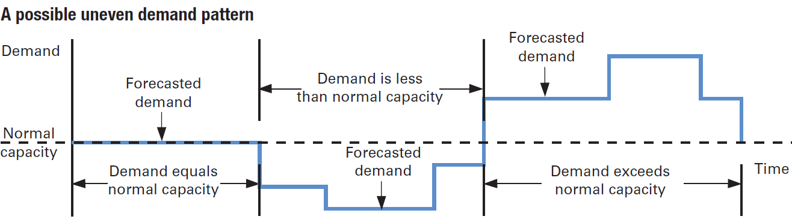
A typical demand pattern

Slide 14
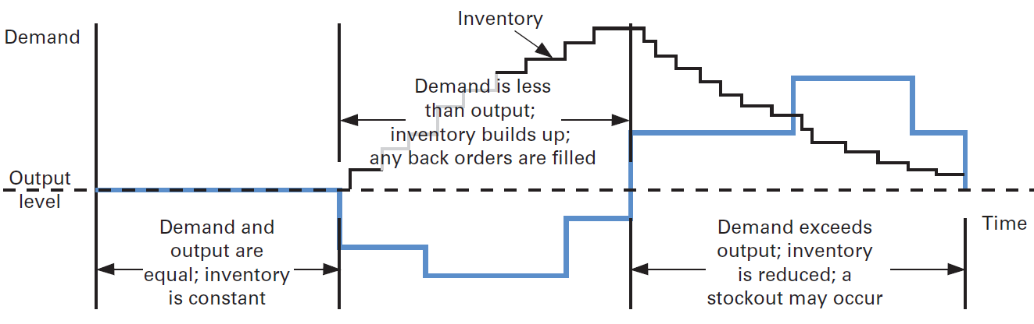
Level Approach
Capacities are kept constant over the planning horizon
Advantages: Stable output rates and workforce
Disadvantages: Greater inventory costs; Increased overtime and idle time; Resource utilizations vary over time

Slide 15
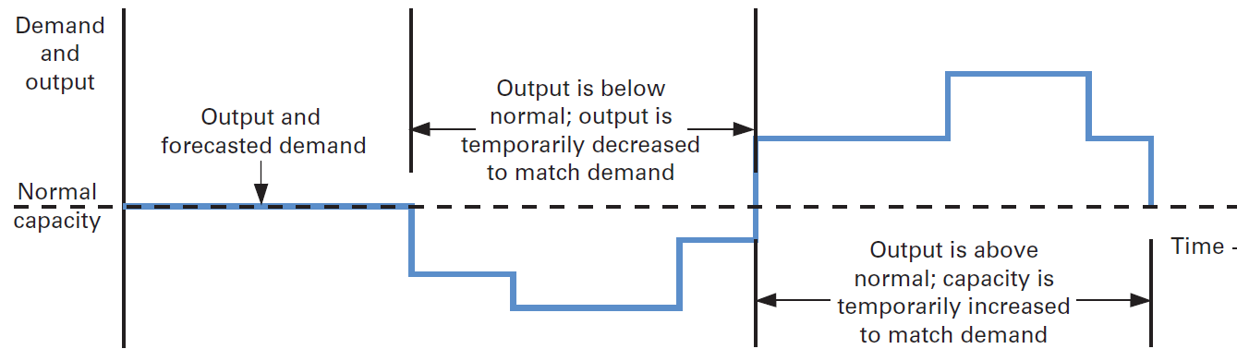
Chase Approach
Capacities are adjusted to match demand requirements over the planning horizon
  Advantages: Investment in inventory is low; Labor utilization in high
  Disadvantages: The cost of adjusting output rates and/or workforce levels

Slide 16
Techniques for Aggregate Planning
General procedure:
  Determine demand for each period
  Determine capacities for each period
  Identify company or departmental policies that are pertinent
  Determine unit costs
  Develop alternative plans and costs
  Select the plan that best satisfies objectives. Otherwise return to step 5.

Slide 17
Trial-and-Error Techniques
Trial-and-error approaches consist of developing simple table or graphs that enable planners to visually compare projected demand requirements with existing capacity
Alternatives are compared based on their total costs
Disadvantage of such an approach is that it does not necessarily result in an optimal aggregate plan

Slide 18
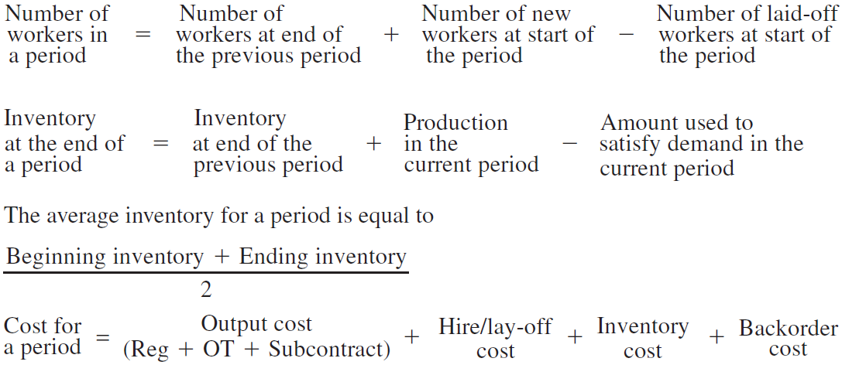
Some formula in Trial-and-Error Techniques

Slide 19
Aggregate Planning Example 1
Planners for a company that makes several models of skateboards are about to prepare an aggregate plan that will cover six periods using the following information. They want to evaluate a plan that calls for a steady rate of regular-time output, mainly using inventory to absorb the uneven demand but allowing some backlog. Overtime and subcontracting are not used because they want steady output. They intend to start with zero inventory on hand in the first period. Prepare an aggregate plan and determine its cost using the preceding information. Assume a level output rate of 300 units (skateboards) per period with regular time (i.e., 1,800/6=300). Note that the planned ending inventory is zero. There are 15 workers, and each can produce 20 skateboards per period.
Period | 1 | 2 | 3 | 4 | 5 | 6 | Total
Forecast | 200 | 200 | 300 | 400 | 500 | 200 | 1,800
Costs Output Regular time = $2 per skateboard Overtime = $3 per skateboard Subcontract = $6 per skateboard Inventory = $1 per skateboard per period on average inventory Back orders = $5 per skateboard per period

Slide 20
Aggregate Planning Example
Period | 1 | 2 | 3 | 4 | 5 | 6 | Total
Forecast | 200 | 200 | 300 | 400 | 500 | 200 | 1,800
Output
Regular time | 300 | 300 | 300 | 300 | 300 | 300 | 1,800
Overtime | --- | --- | --- | --- | --- | ---
Subcontract | --- | --- | --- | --- | --- | ---
Inventory
Output 2 Forecast | 100 | 100 | 0 | (100) | (200) | 100 | 0
Inventory
Beginning | 0 | 100 | 200 | 200 | 100 | 0
Ending | 100 | 200 | 200 | 100 | 0 | 0
Average | 50 | 150 | 200 | 150 | 50 | 0 | 600
Backlog | 0 | 0 | 0 | 0 | 100 | 0 | 100

Slide 21
Aggregate Planning Example
Period | 1 | 2 | 3 | 4 | 5 | 6 | Total
Costs
Output
Regular time | $600 | $600 | $600 | $600 | $600 | $600 | $3,600
Overtime | --- | --- | --- | --- | --- | ---
Subcontract | --- | --- | --- | --- | --- | ---
Hire/Layoff | --- | --- | --- | --- | --- | ---
Inventory | $50 | $150 | $200 | $150 | $50 | $0 | $600
Backlog | $0 | $0 | $0 | $0 | $500 | $0 | $500
Total | $650 | $750 | $800 | $750 | $1,150 | $600 | $4,700
Total cost of aggregate plan: $4,700

Slide 22
Aggregate Planning Example 2
After reviewing the plan developed in the preceding example 1, planners have decided to develop an alternative plan. They have learned that one person is about to retire from the company. Rather than replace that person, they would like to stay with the smaller workforce and use overtime to make up for the lost output. The reduced regular-time output is 280 units per period. The maximum amount of overtime output per period is 40 units. Develop a plan and compare it to the previous one.

Slide 23
Aggregate Planning Example
Period | 1 | 2 | 3 | 4 | 5 | 6 | Total
Forecast | 200 | 200 | 300 | 400 | 500 | 200 | 1,800
Output
Regular time | 280 | 280 | 280 | 280 | 280 | 280 | 1680
Overtime | --- | --- | 40 | 40 | 40 | --- | 120
Subcontract | --- | --- | --- | --- | --- | ---
Inventory
Output 2 Forecast | 80 | 80 | 20 | (80) | (180) | 80 | 0
Inventory
Beginning | 0 | 80 | 160 | 180 | 100 | 0
Ending | 80 | 160 | 180 | 100 | 0 | 0
Average | 40 | 120 | 170 | 140 | 50 | 0 | 520
Backlog | 0 | 0 | 0 | 0 | 80 | 0 | 80

Slide 24
Aggregate Planning Example
Period | 1 | 2 | 3 | 4 | 5 | 6 | Total
Costs
Output
Regular time | $560 | $560 | $560 | $560 | $560 | $560 | $3360
Overtime | --- | --- | $120 | $120 | $120 | --- | $360
Subcontract | --- | --- | --- | --- | --- | ---
Hire/Layoff | --- | --- | --- | --- | --- | ---
Inventory | $40 | $120 | $170 | $140 | $50 | 0 | $520
Backlog | $0 | $0 | $0 | $0 | $400 | $0 | $400
Total | $600 | $680 | $850 | $820 | $1,130 | $560 | $4640
Total cost of aggregate plan: $4,640
Which plan should be chosen? Why?

Slide 25
Disaggregation
Aggregate
Plan
Disaggregation
Master
Schedule

Slide 26
Question

